Slide 1


RBI for CUI, Is This Thing Working?
An Overview of Semi-Quantitative, RBI Inputs for External Corrosion
January 23 - 25, 2024 | Henry B. Gonzales Center | San Antonio, TX

Slide 2

BIO SLIDE
Robert Sladek
Becht
RBI Group Lead
35 Years in the Industry
Inspection, RBI, Mechanical Integrity
Industry Involvement:
  API 581: Vice-Chair from 2012-2018; Chair 2019 to current
  API 580: Vice Chair 4th Edition
  API 575: Chair 5th Edition
  API Summit since 2012 in various roles including Assistant Sector Lead, Track Lead, Coordinator, Moderator and Presenter.

Slide 3
RBI for CUI, Is This Thing Working?
This presentation focuses on the API 581 inputs which influence the damage rate for External Corrosion and CUI
    Background
    External Corrosion vs CUI Comparison
    Base Corrosion Rate
    Final Corrosion Rate
    Example Problem
    Determining age with Coating Credit
    Conclusion/Summary

Slide 4
Background
API 581 was originally published in May 2000 as the Base Resource Document
  The only industry consensus and published RBI methodology
  Internal and external damage calculations since inception
  Industry focus has been on the internal damage
External Damage Calculations
  Forms the basis for most of the popular RBI methodologies/software today
  External “corrosion” modules (based on General Thinning calculations)
    Determine a base corrosion rate using Driver and Temperature
    Modify that rate based on Factors (e.g., Design, insulation type)
    Ability to delay the onset of corrosion based on coating quality.
Output is a “Calculated” Rate

Slide 5
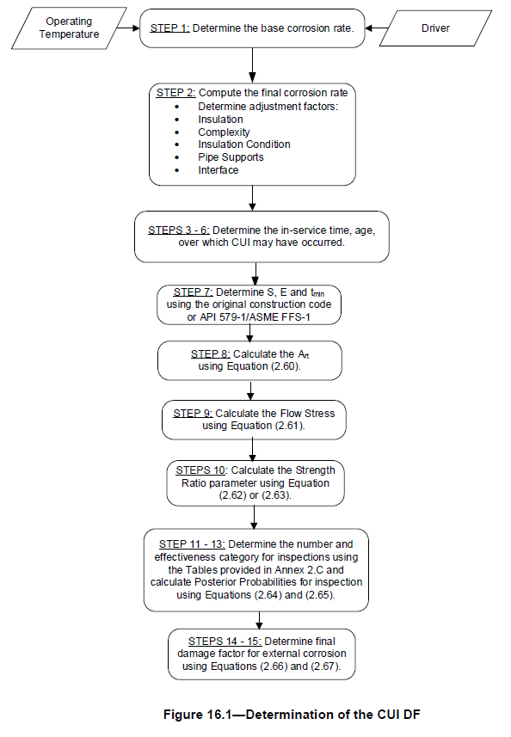
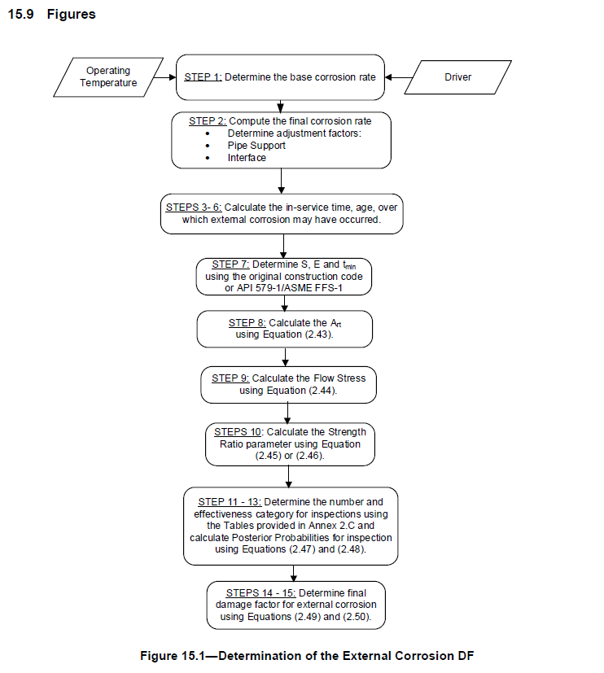
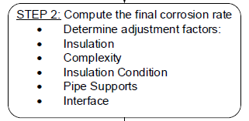

External Corrosion vs CUI

Slide 6
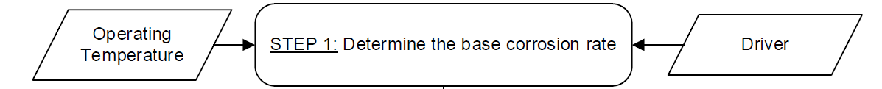
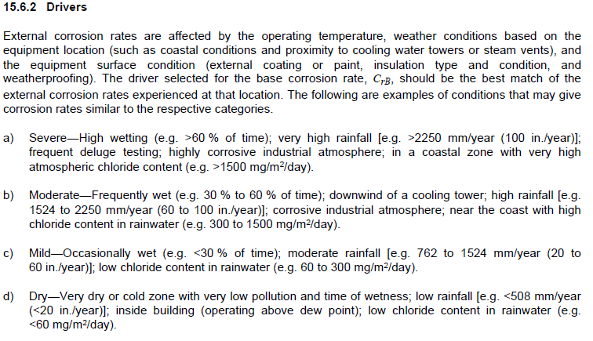
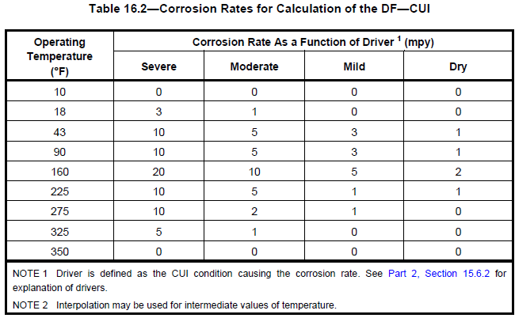
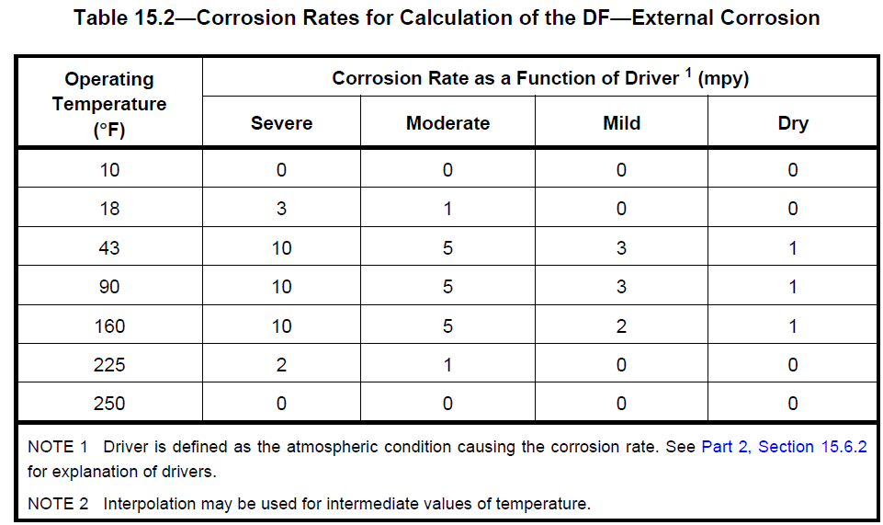
Base Corrosion Rate

Slide 7

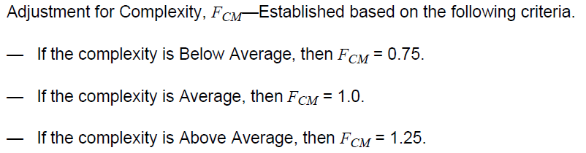
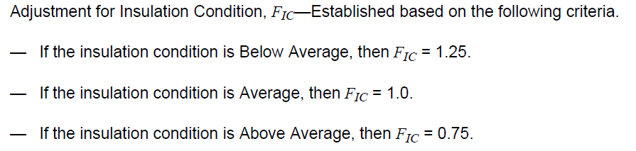
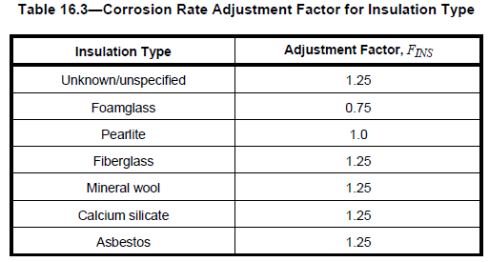
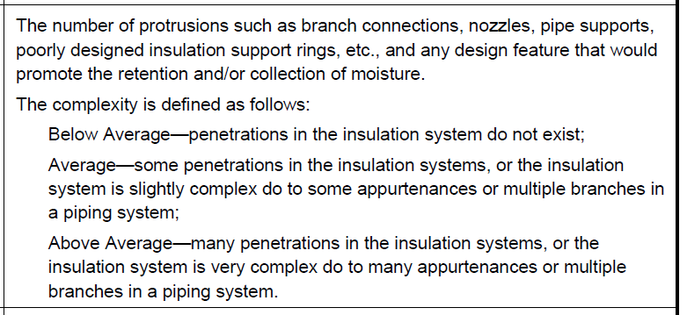
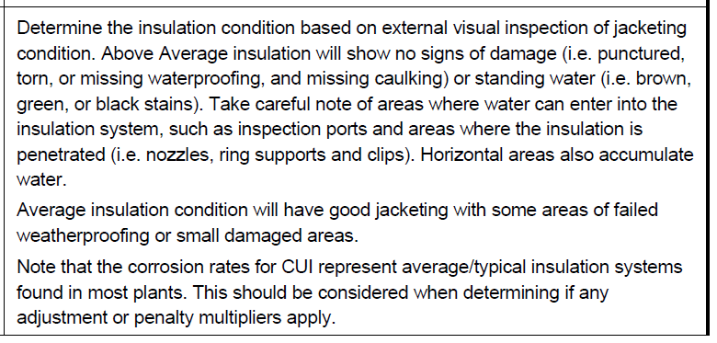
Final Corrosion Rate
External Corrosion
Section 15
CUI
Section 16
Rate = C_{rB} x max [F_{EQ} , F_{IF} ]
Rate = C_{rB} x F_{INS} x F_{CM} x F_{IC} x max [F_{EQ} , F_{IF} ]

Slide 8
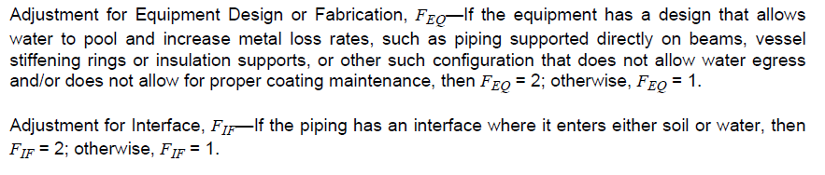
CUI Corrosion Rate Example
CUI Example Case
C_{r} = C_{rB} x F_{INS} x F_{CM} x F_{IC} x max [F_{EQ} , F_{IF} ]
C_{r} =
10 x
1.25 x
1 x
1.25 x
max[ 2,
1 ]
Insulated, C/S Piping circuit
From Pump, through control loop and into a drum
Gulf Coast location (Moderate)
Operating Temp ~160F
Cal-sil Insulation, multiple damage areas
Rack portions rest directly on support beams
C_{r} = 15.625 x 2
C_{r} = 31.25 mpy
Parameter | Value
C_{rb} | 10
F_{INS} | 1.25
F_{CM} | 1.0
F_{IC} | 1.25
F_{EQ} | 2
F_{IF} | 1

Slide 9
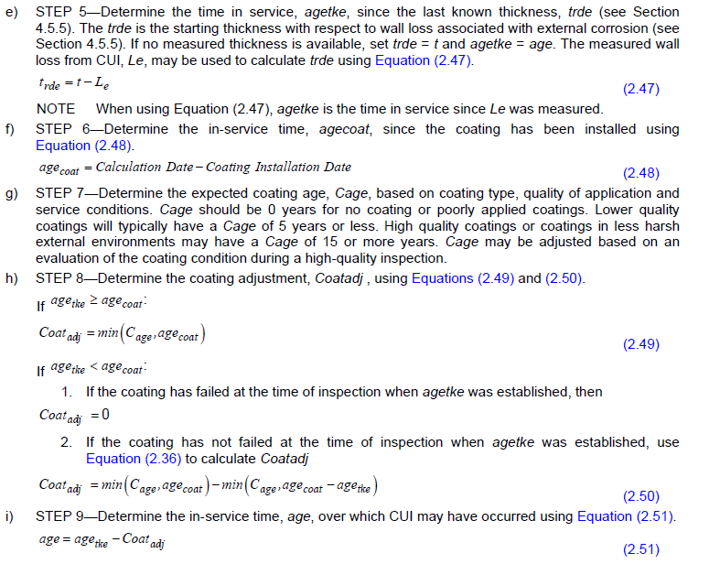
Determining age with Coating Credit
Coating credit allows the user to delay the onset of corrosion based on Coating Type, Quality and Service Conditions

Slide 10
Summary
External Corrosion vs CUI:
  Basically, the same calculation,
  CUI has more adjustment factors
The methodology used at your site is probably similar
Standardization for Relative Risk:
  Understand the inputs
  Modify as needed but document your basis, with justification
  Gather and record the data
Are Inspectors reporting the inputs needed
    Training

